Slide 1

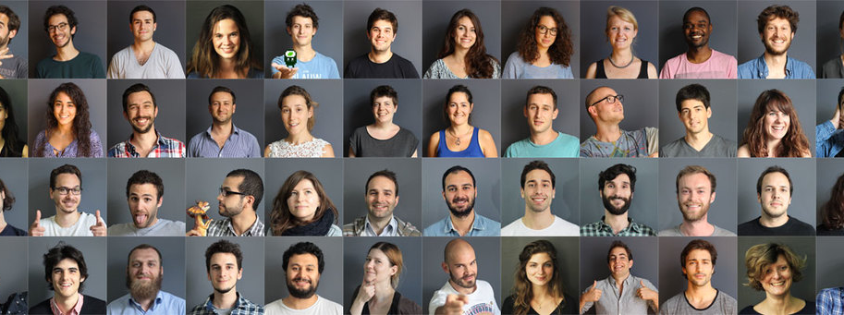


Slide 2








Slide 3


Bring technical skills
to creative people

Slide 4
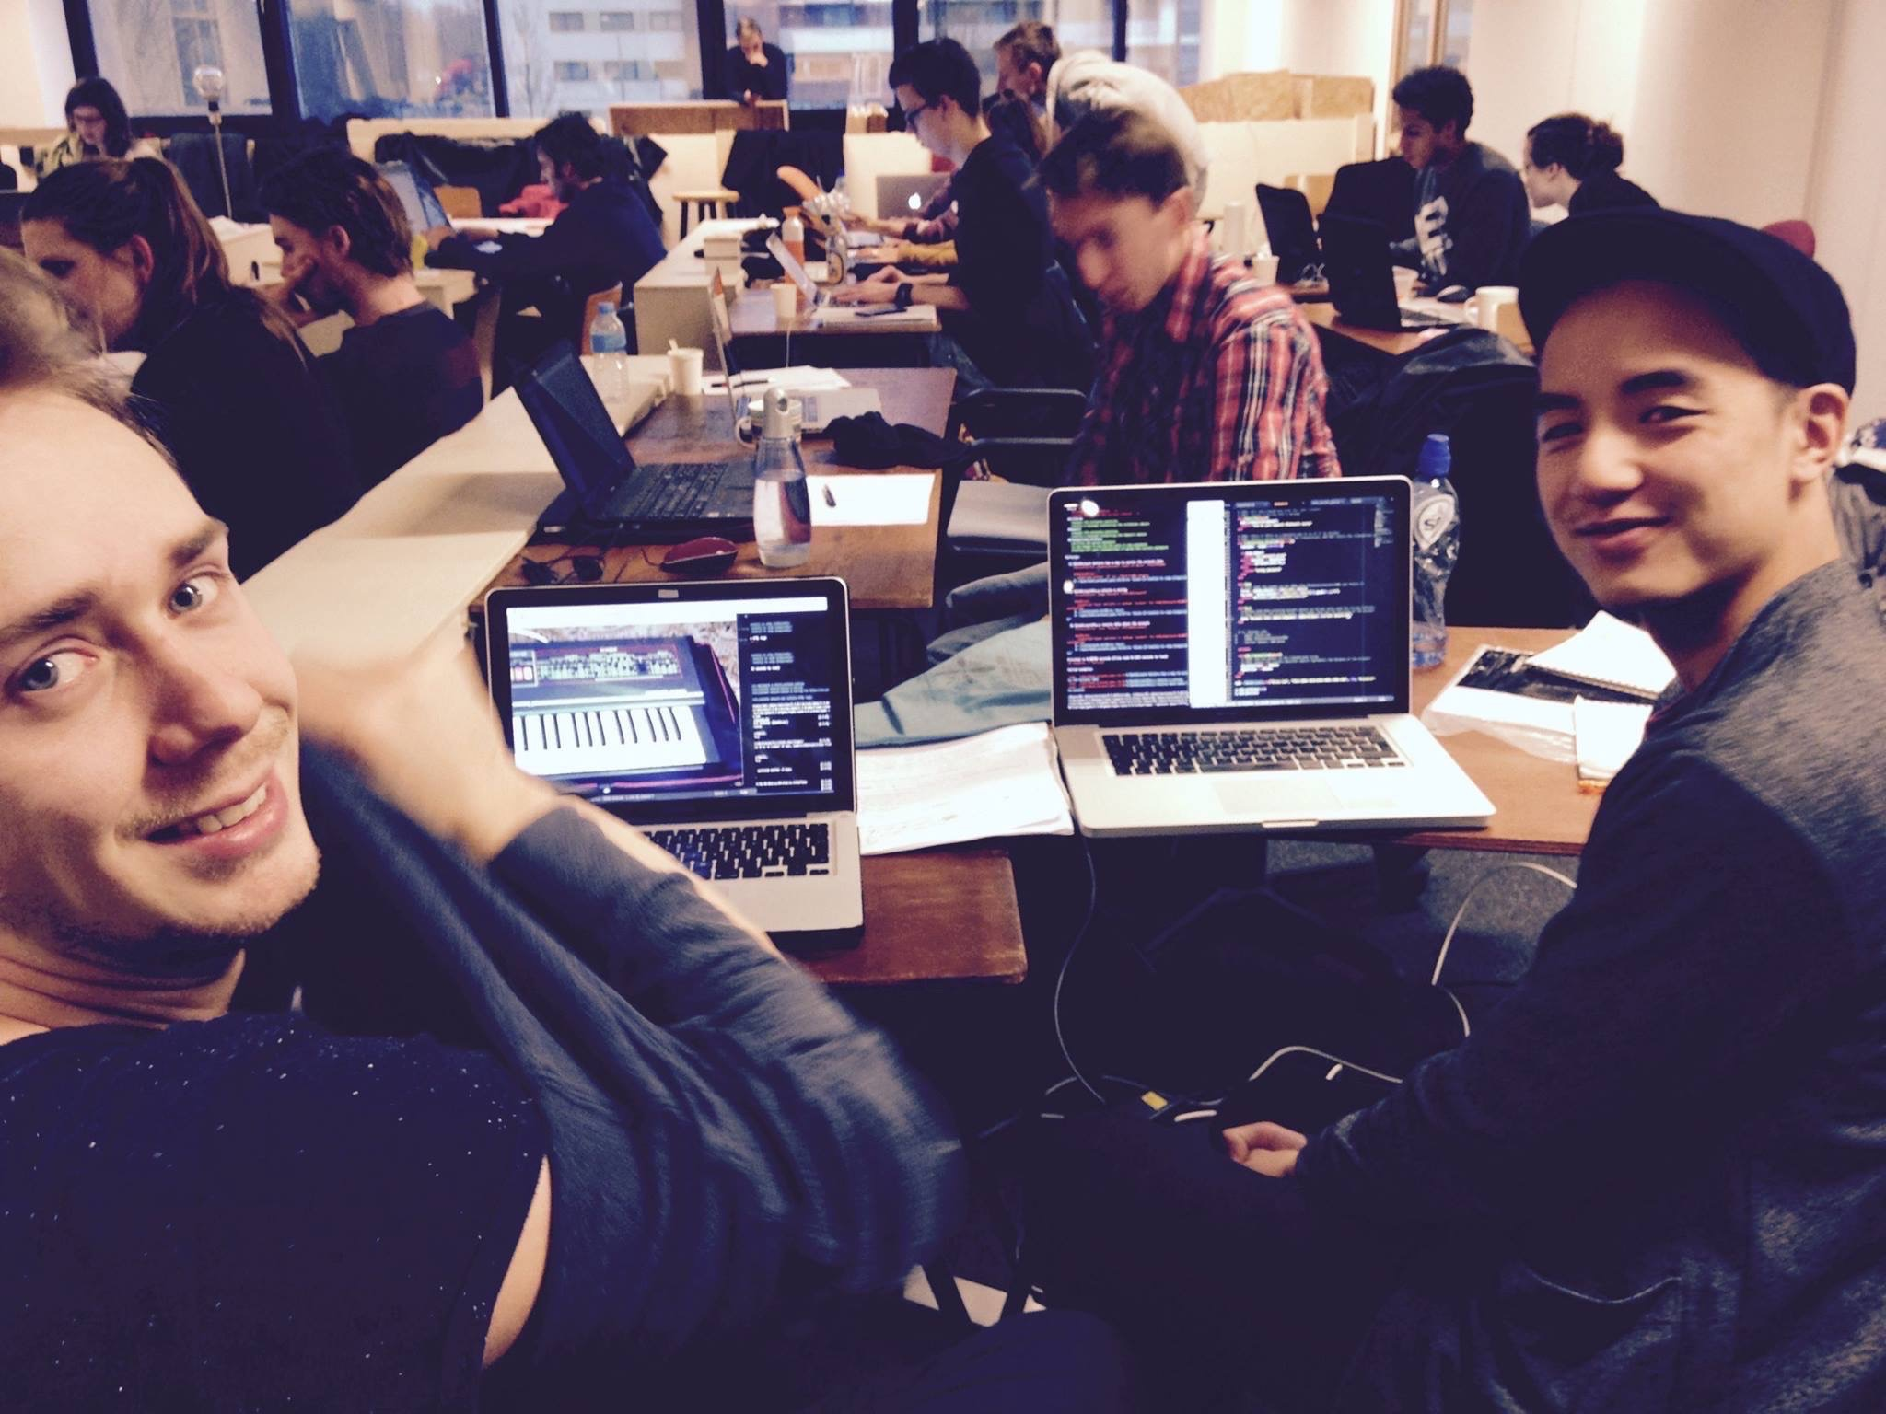

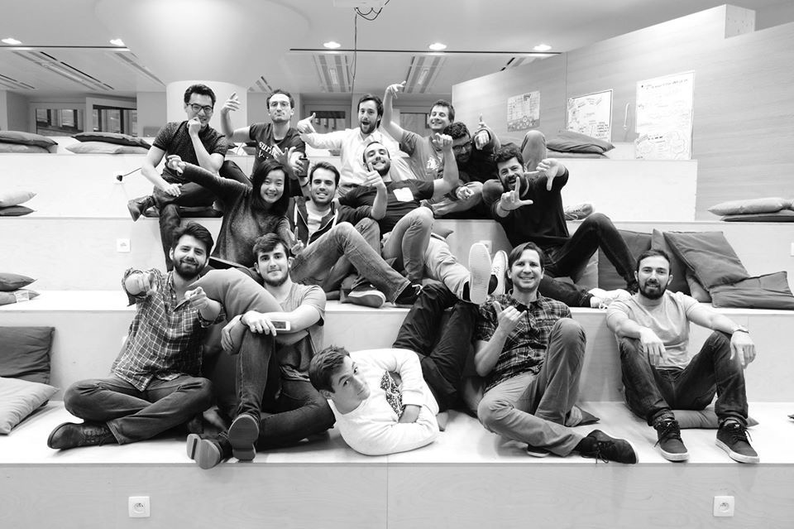
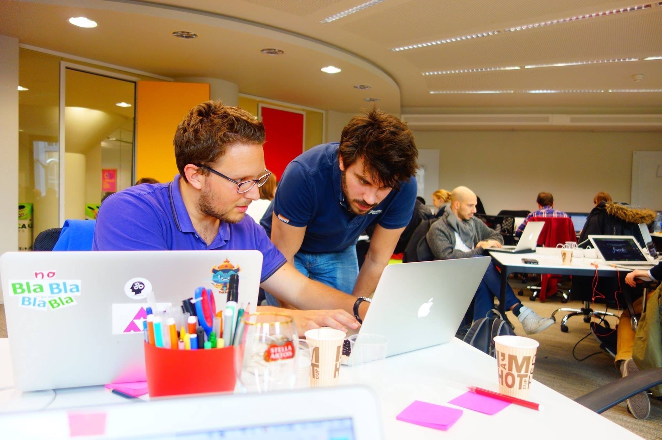
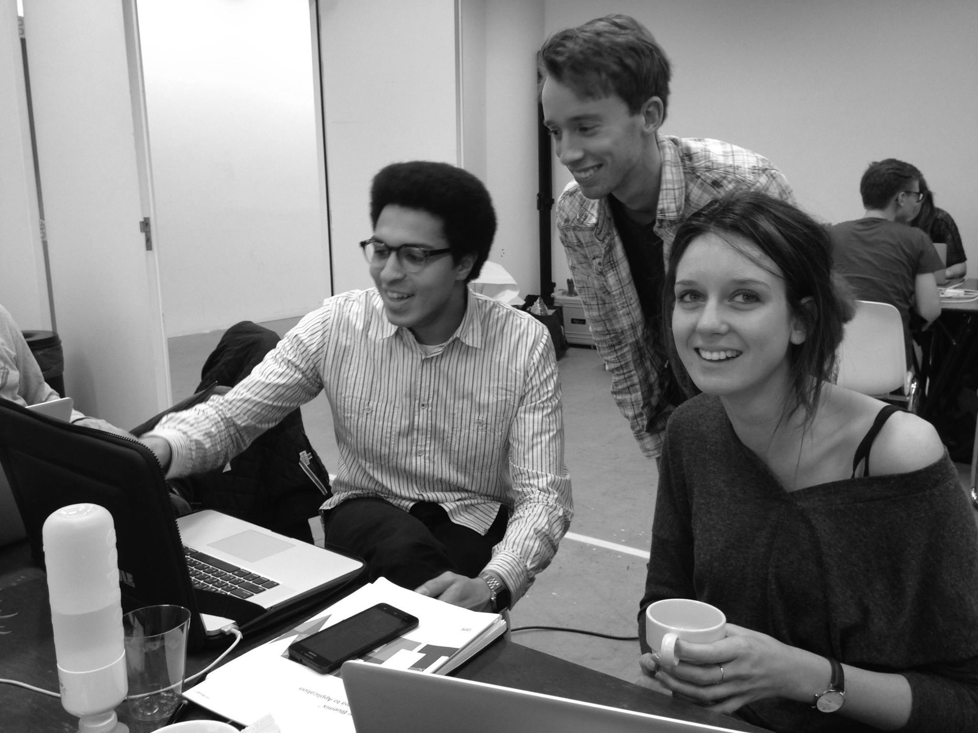
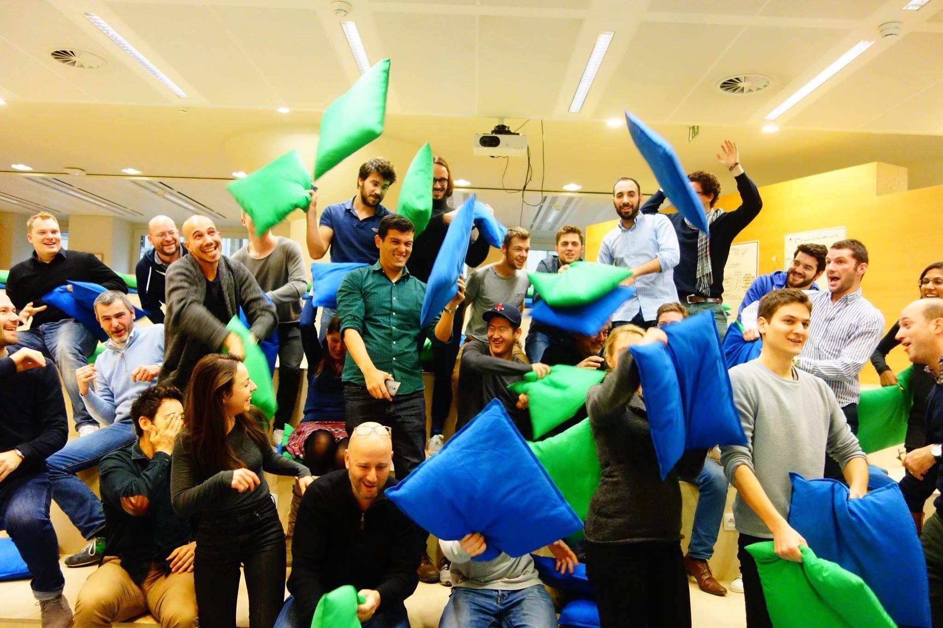
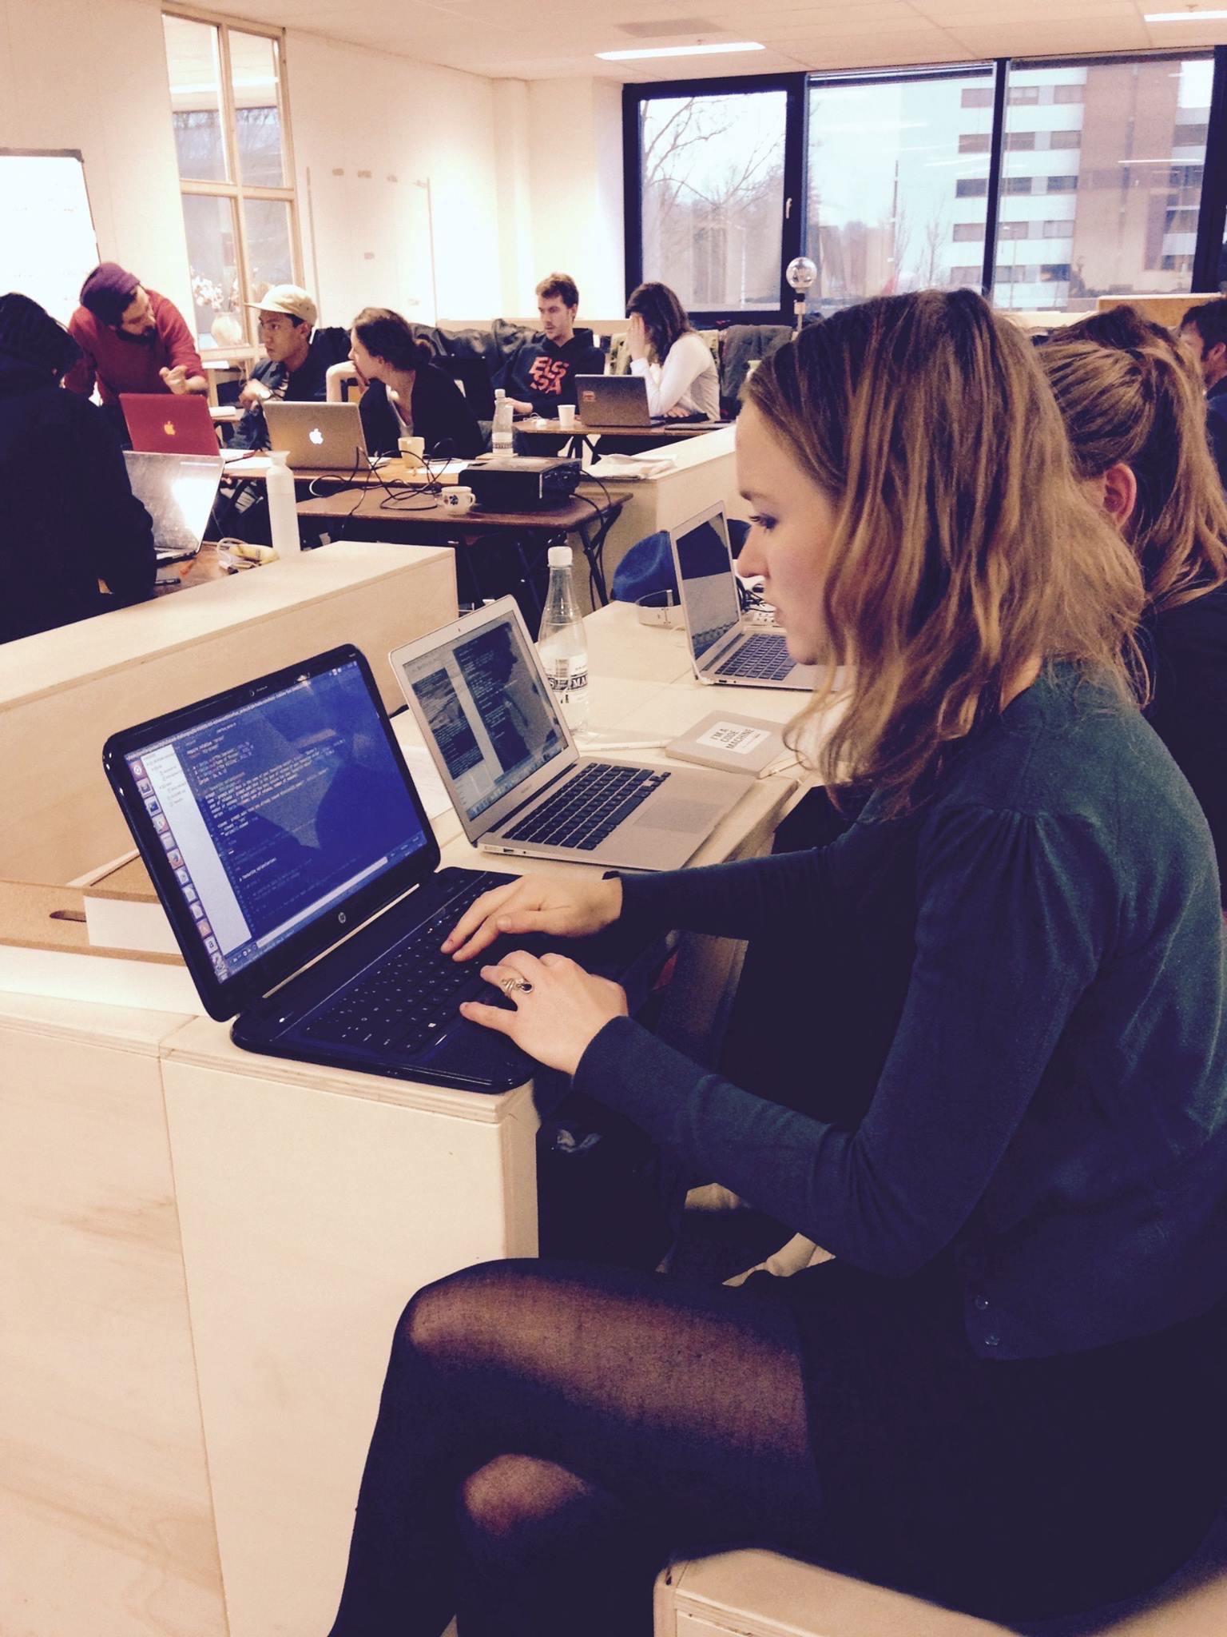



Slide 5
Community Workshops
Mon 05 Dec
HTML/CSS introduction
Technical workflow in Startups
Git & GitHub for Beginners
Product specs 101
Launch your product: Tools & Metrics
Sketch UI Design Crash Course
Tue 06 Dec
Thu 08 Dec
Tue 13 Dec
Tue 10 Jan
Tue 17 Jan

Slide 6
CSS components
design

Slide 7
Components 101
Easy CSS tricks
Advanced patterns

Slide 8
UI components
==
Elementary blocks
of app design

Slide 9
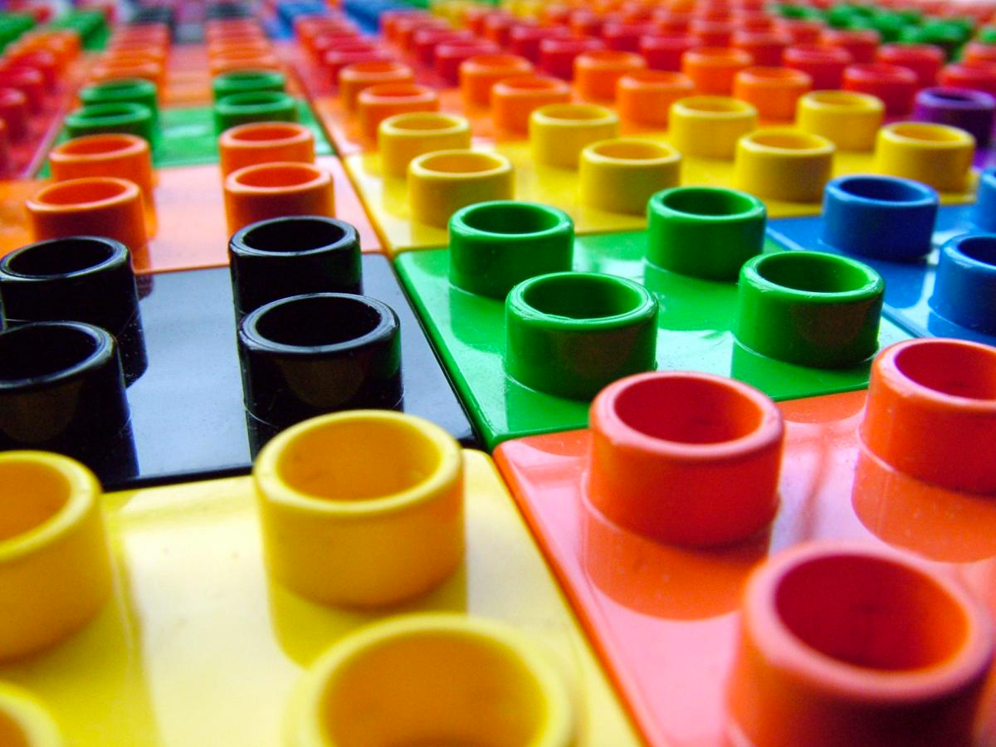
5 to 10 components to master
90% of your app design

Slide 10
Which UI components
do you know?

Slide 11


Images
Avatar
Thumbnail

Slide 12
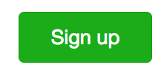
Buttons
WeChat
SIGN UP
Google
Write a story
Medium
Free trial
treehouse

Slide 13
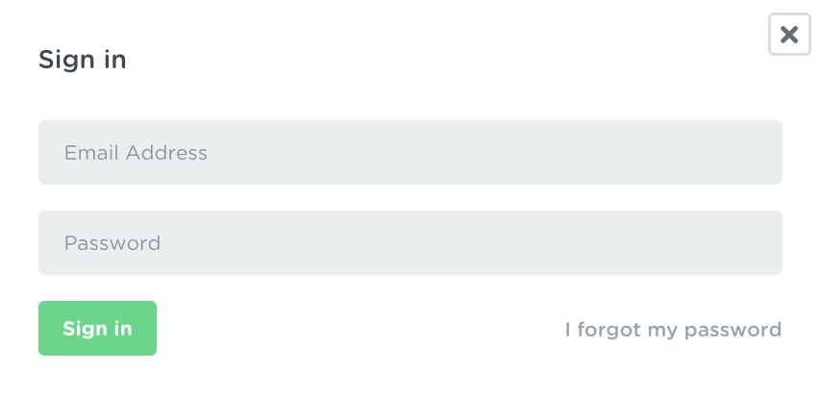
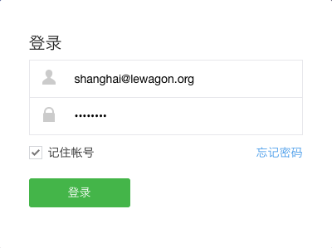
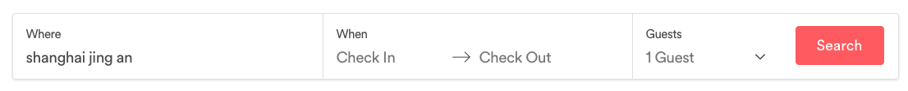
Forms
Login forms (treehouse)
(wechat)
Search form (airbnb)

Slide 14
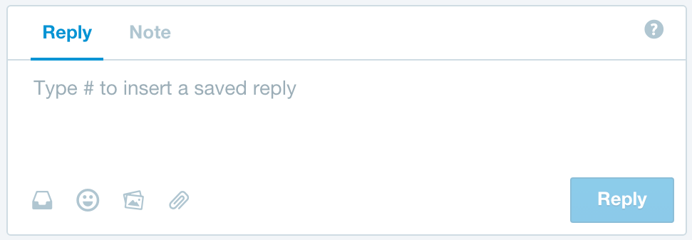
Forms
Chatbox form (Intercom)

Slide 15
Tabs / Navs
Medium
ProductHunt
Twitter

Slide 16
Navbars
Medium
Twitter
Github

Slide 17
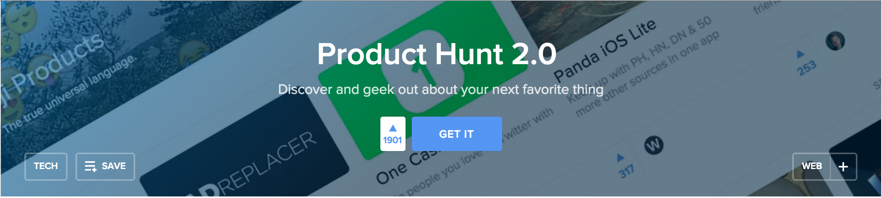
Banners

Slide 18
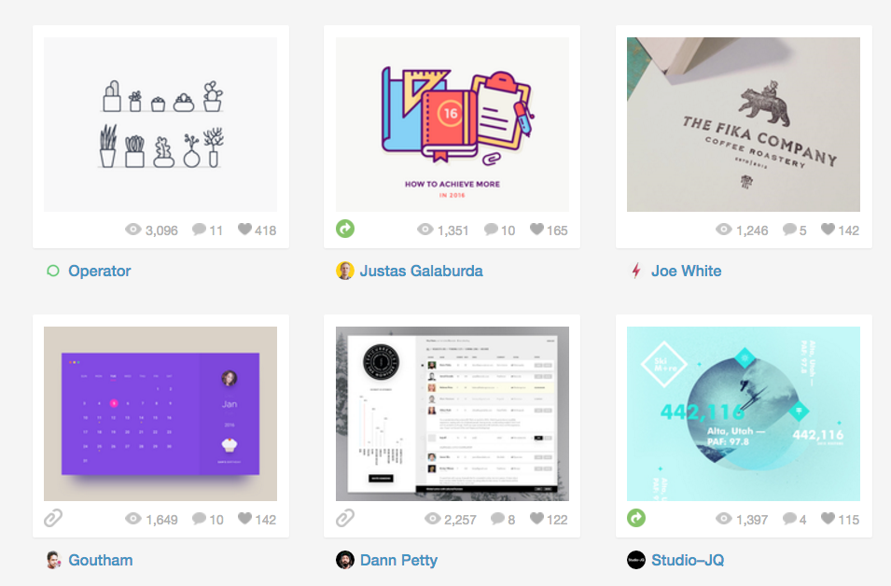
Cards

Slide 19
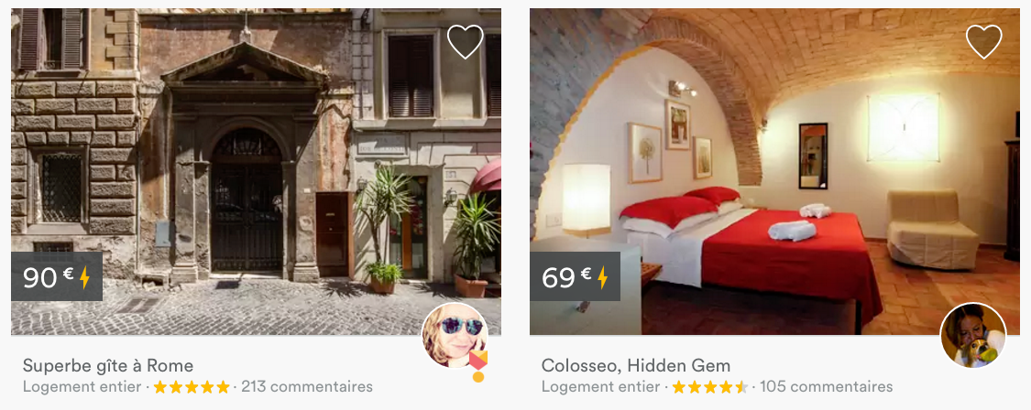
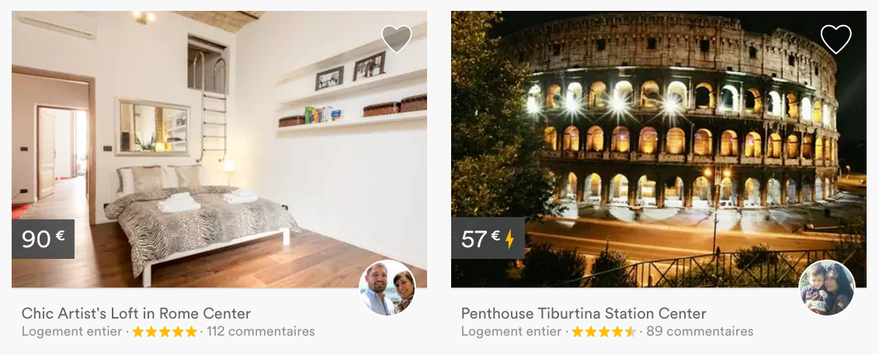
Cards

Slide 20
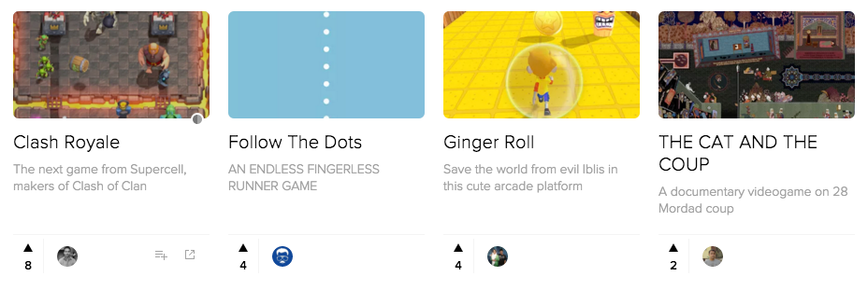
Cards

Slide 21
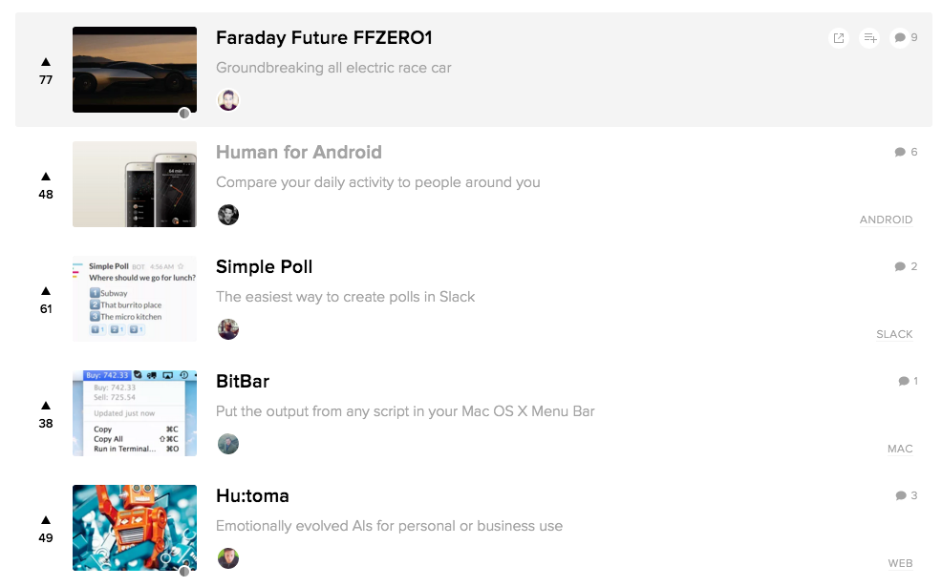
Lists

Slide 22
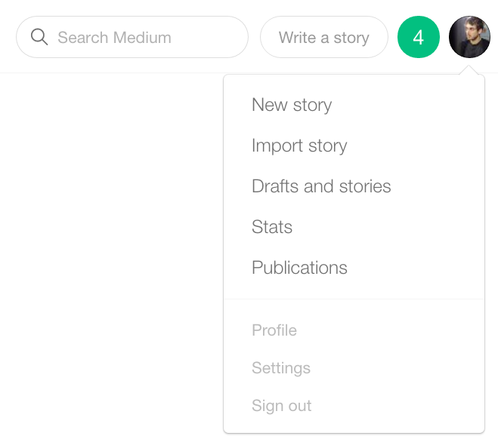
Dropdown

Slide 23



Setup

Slide 24
Starting Boilerplate
Download ZIP or clone
http://tinyurl.com/ui-sprint

Slide 25
Easy CSS examples
Let’s code together
Avatars
Buttons
Dropdowns

Slide 26
CSS advanced
patterns

Slide 27
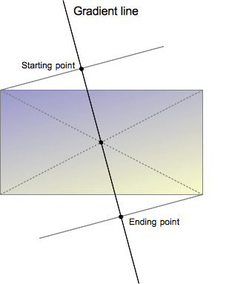
Gradient filter CSS

Slide 28
Gradient filter CSS
background: linear-gradient(angle,
start_color start_point,
end_color end_point),
url('background.jpg');
background: linear-gradient(135deg,
yellow 0%,
green 50%),
url('background.jpg');

Slide 29

Relative position
Offset from initial position
A way to pin an element
Let’s offset logo on https://www.lewagon.com/

Slide 30
Absolute position
Offset from 1st positioned parent
If no pinned parent => body

Slide 31
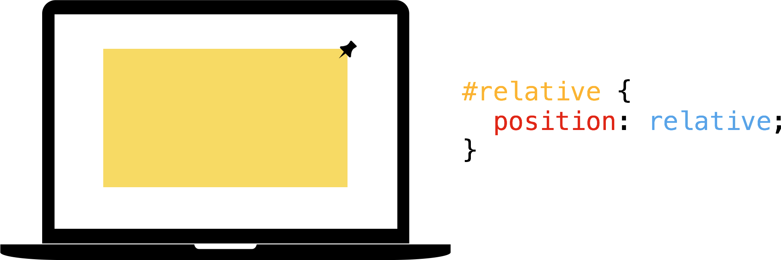
Relative / Absolute pattern

Slide 32
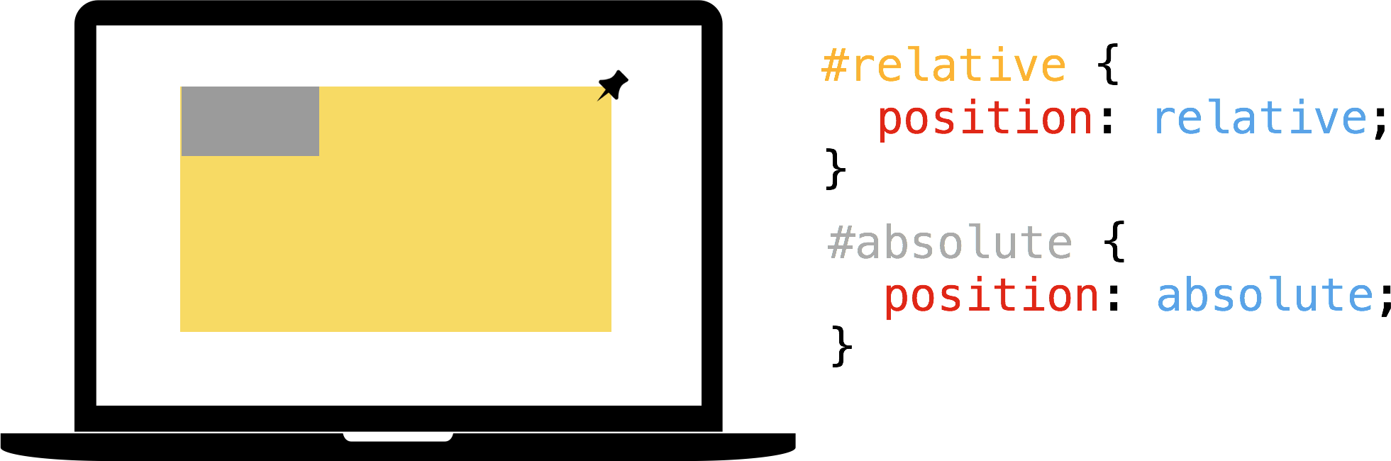
Relative / Absolute pattern

Slide 33
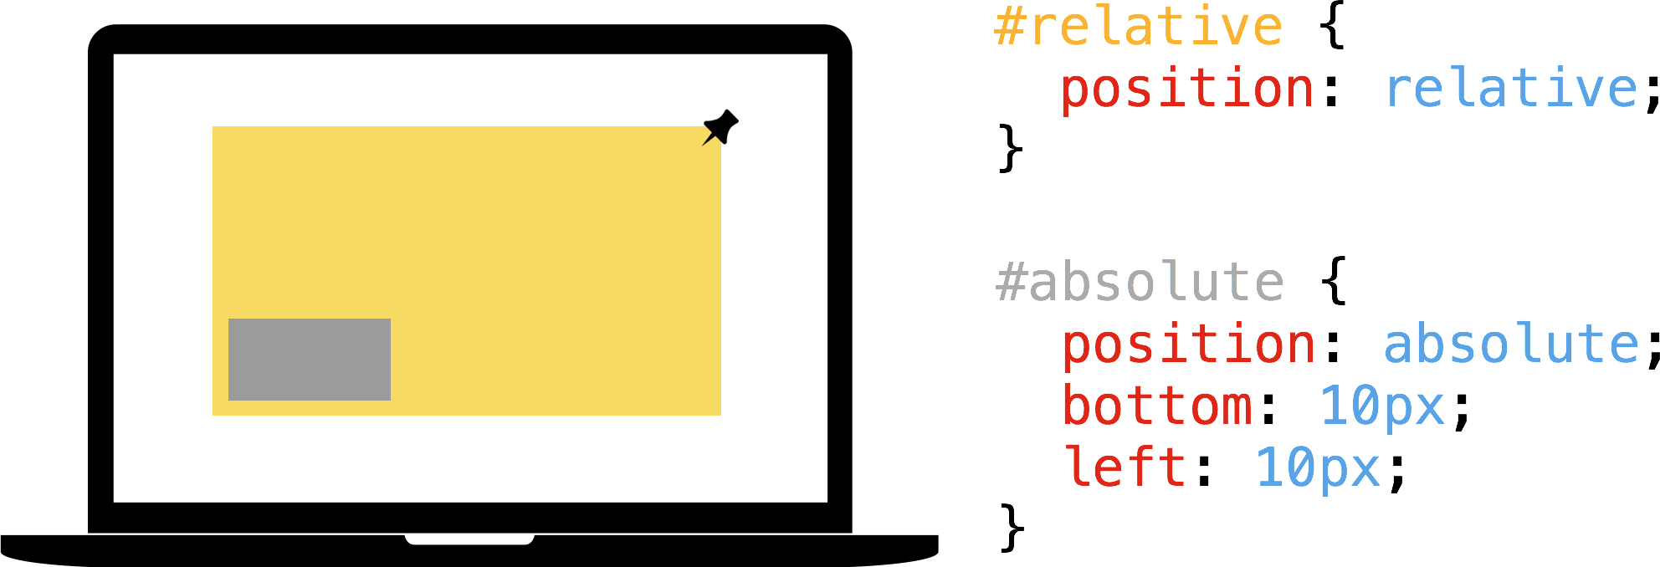
Relative / Absolute pattern

Slide 34
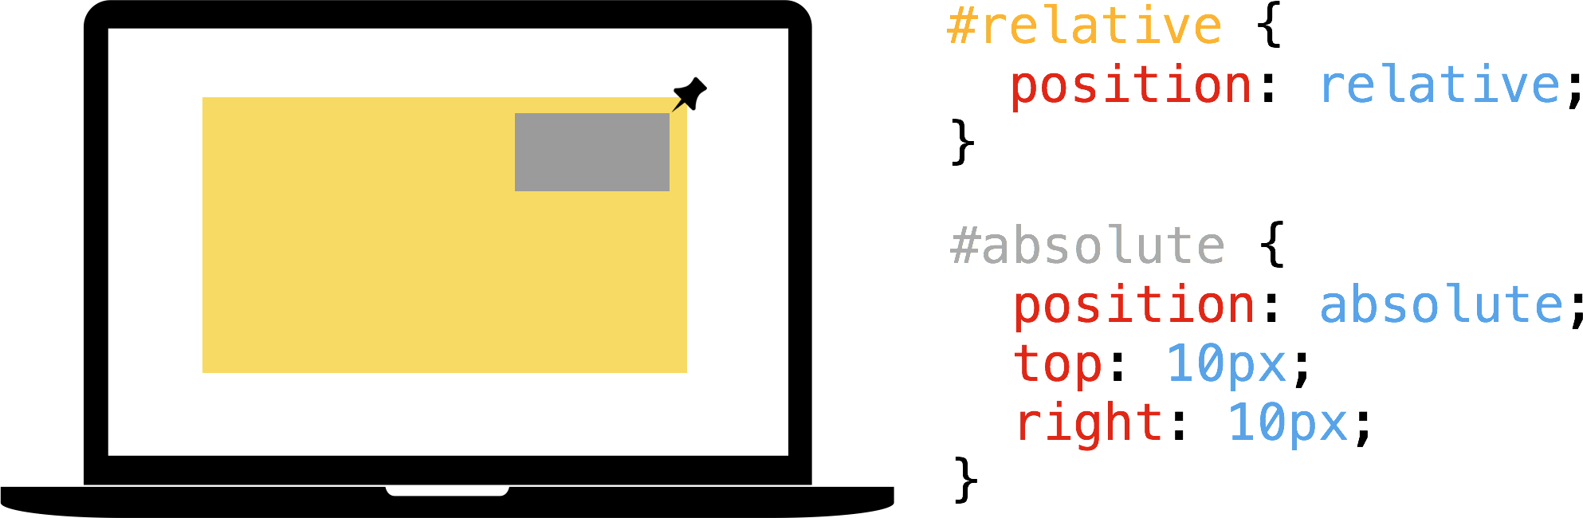
Relative / Absolute pattern

Slide 35
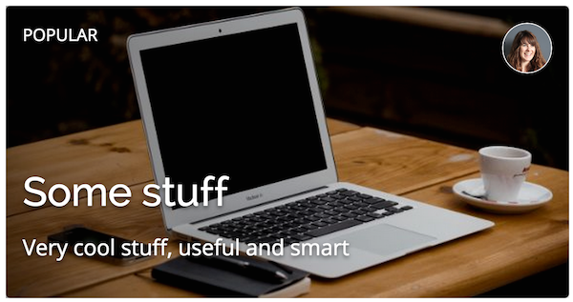
Relative / Absolute pattern
card design

Slide 36

Relative / Absolute pattern
badge design

Slide 37
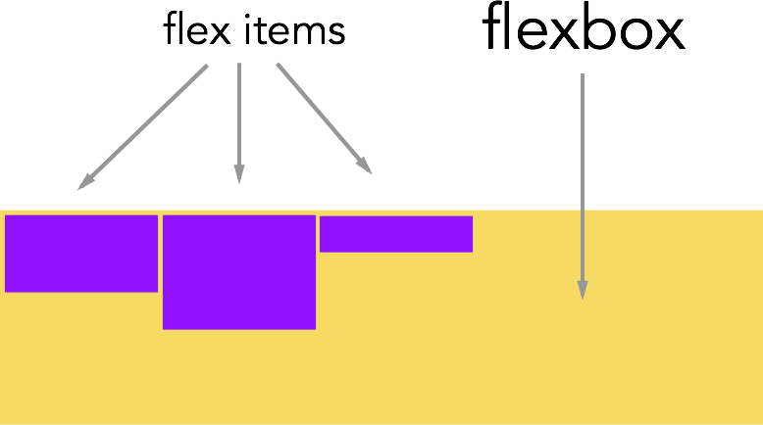
Flexbox - Vocabulary

Slide 38
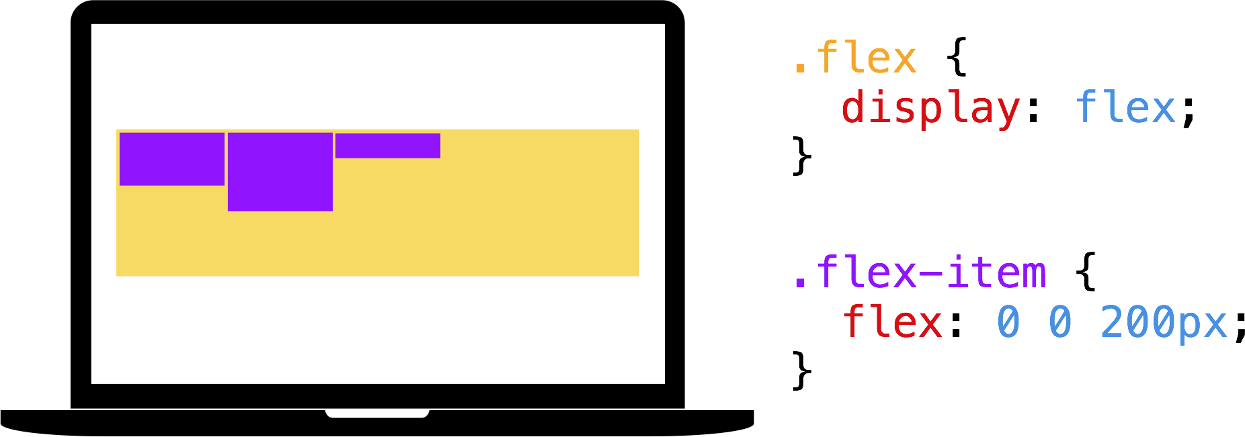
Flexbox

Slide 39
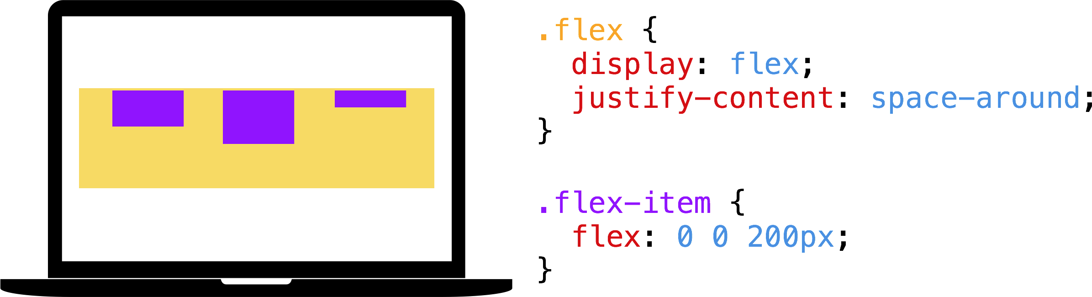
Flexbox

Slide 40
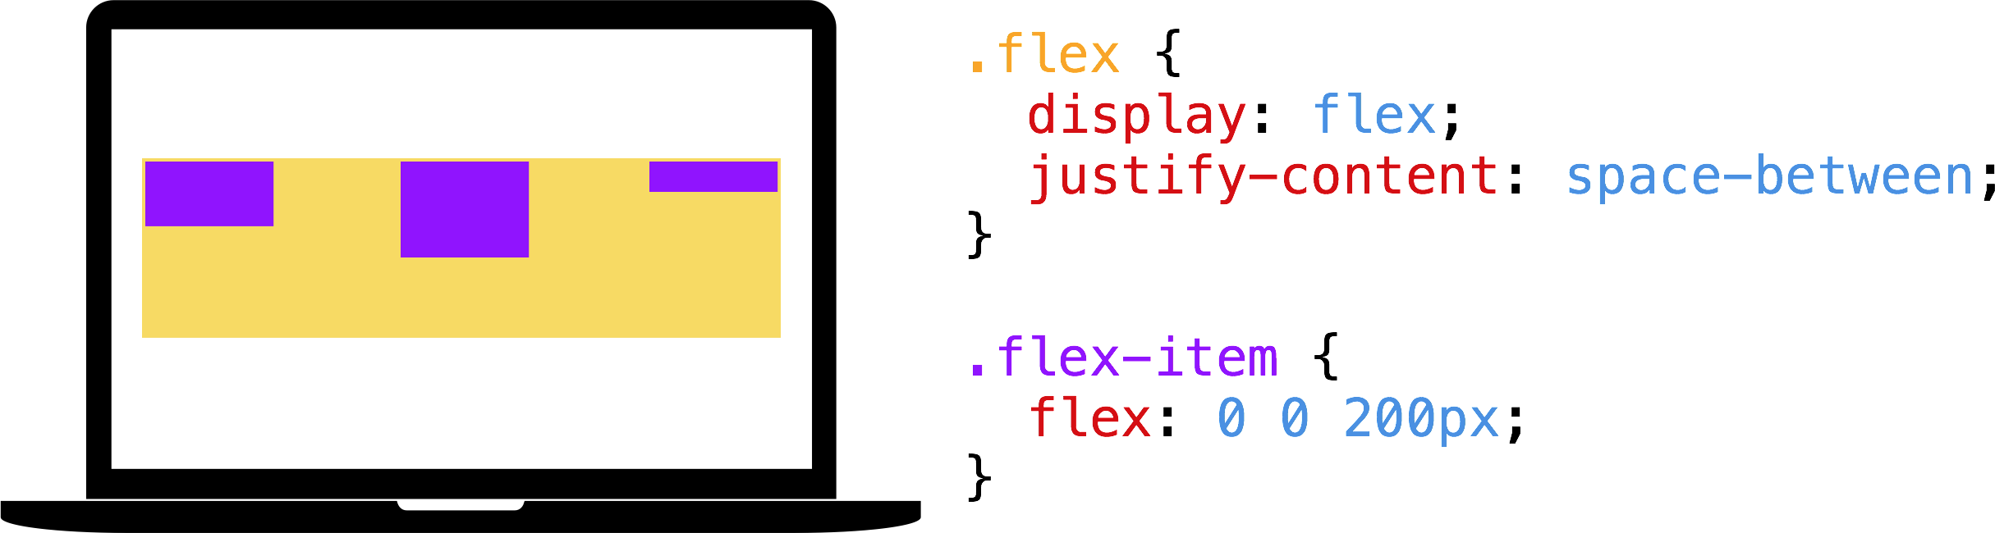
Flexbox

Slide 41
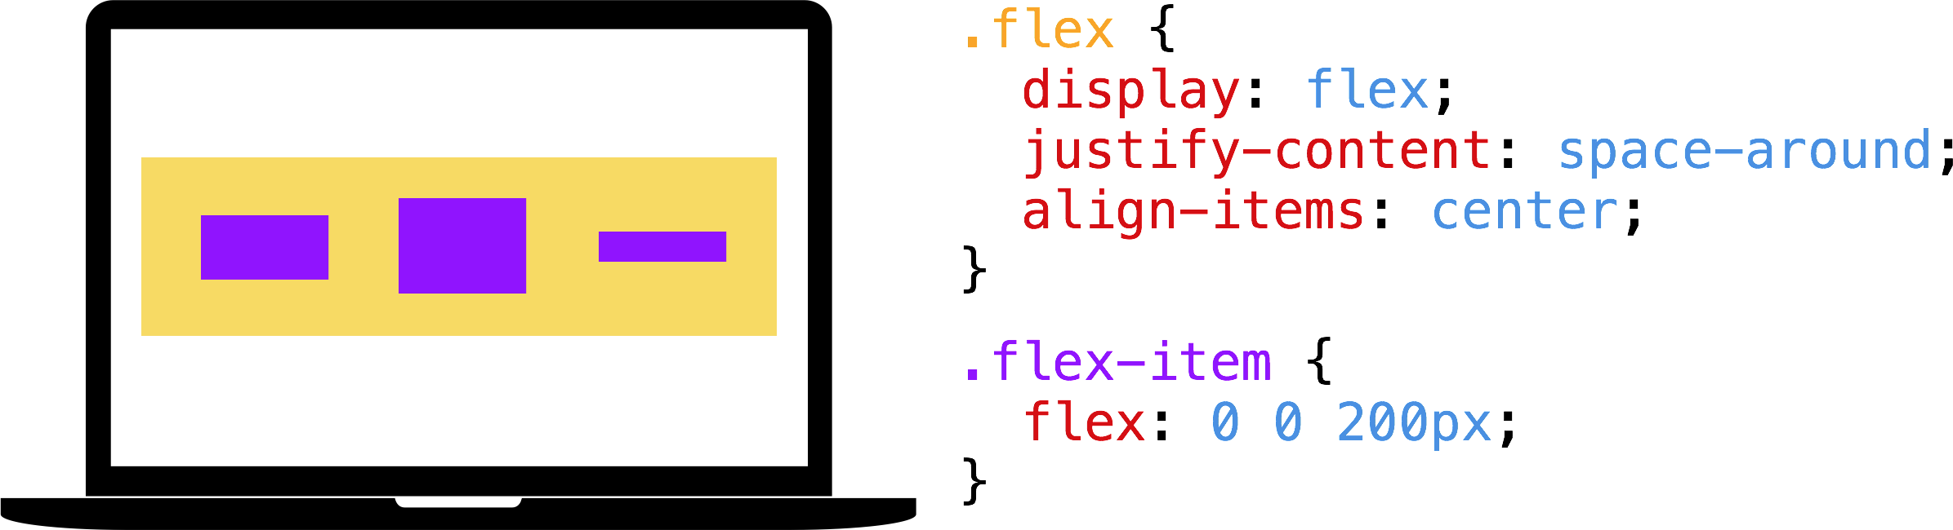
Flexbox

Slide 42
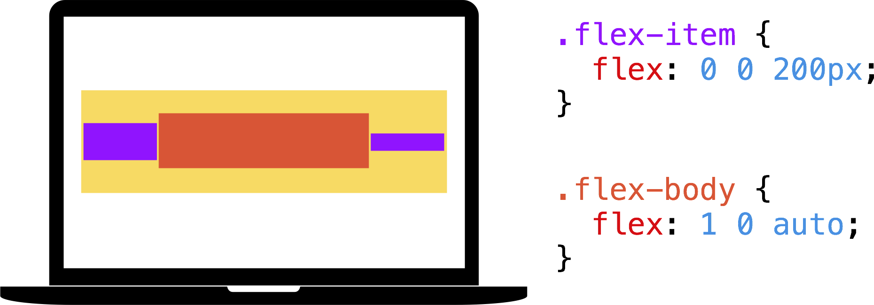
Flexbox

Slide 43
Flexbox example
Banner design (centering on horizontal & vertical axis)

Slide 44
Flexbox example
tab design

Slide 45
Flexbox example
list item design

Slide 46

Small gift
lewagon.github.io/ui-components/
Go further
http://lewagon.com/shanghai

Slide 47
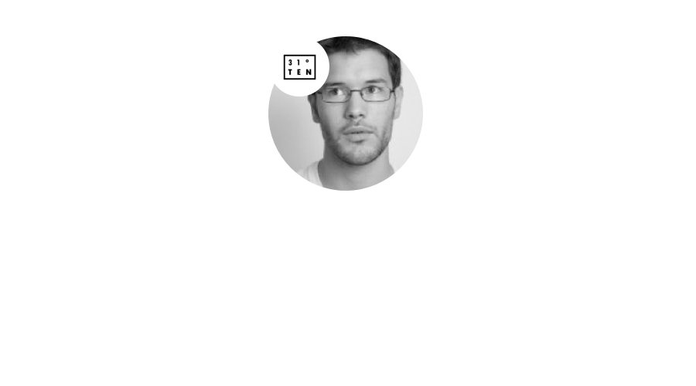
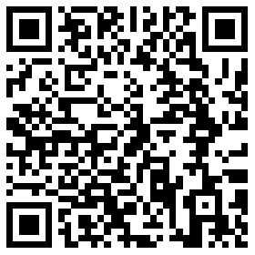

Slide 48
Thank you!

